Slide 1
Human Factors in Work-Life Balance
Elsy Hernández
University of Idaho

Slide 2
Agenda
Work Culture
Japan
European Countries
Striving Towards Balance
Bringing It All Together

Slide 3
What is a positive work culture?
Treating colleagues as friends, caring for them, and being interested in their wellbeing.
Supporting colleagues and offering compassion and kindness in times of need.
Forgiving mistakes and not assigning blame.
Working to inspire each other.
Finding and emphasizing meaningful aspects of the work.
Prioritizing trust, respect, gratitude, and integrity.

Slide 4

Positive Work Culture Benefits
Improved Employee Health
Reduced Turnover
Increased Loyalty and Reduced Negative Behaviors
Better Performance Outcomes

Slide 5
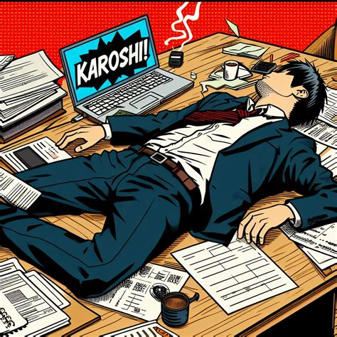
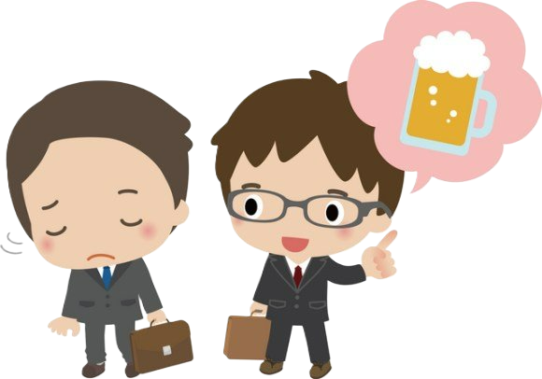
Japan
Traditional Concepts
Karoshi
Nomikai
Implemented Changes and Benefits
Japanese Government Efforts
Transportation Expenses
Health Insurance
Employment Stability

Slide 6

Nordic Countries
The Nordic Theory of Everything
Anu Partanen

Slide 7


Slide 8
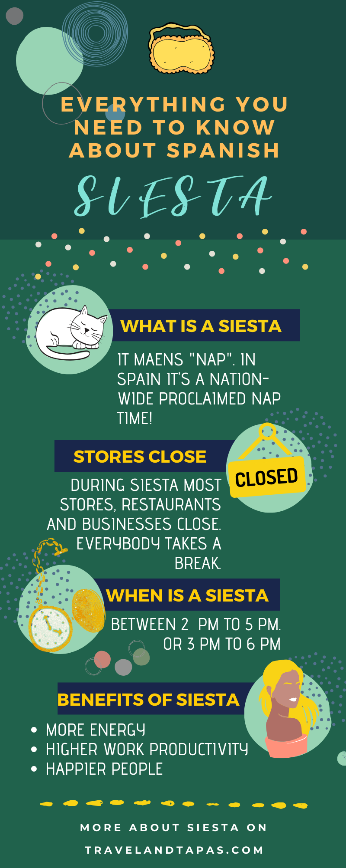
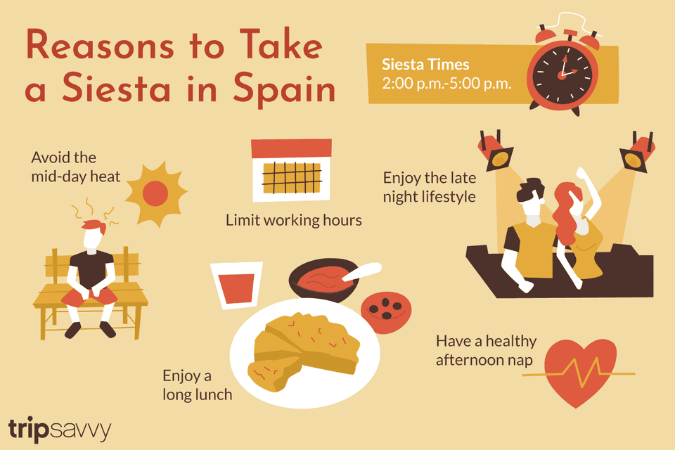
Spain
Siesta

Slide 9

Striving Towards Balance
Organized Training
Regular Re-Training
Education
Management
Workplace Ergonomics

Slide 10

Bringing It All Together
Positive Work Culture
Environment
Team Dynamics
Treatment
Cultural and Historical Influences
Human Factor Approaches
Ergonomics
Management

Slide 11
References
Andreev, I. (2024, November 11). Work Culture. Valamis. https://www.valamis.com/hub/work-culture
Benton, L., & Kyte, L. (2019, September 23). A Culture Change Success Story. United Kingdom; Lizzie Benton. https://libertymind.co.uk/podcasts/season-2-episode-4-a-culture-change-success-story/
Dev, J. (2023, July 1). Japanese Work Culture: Here’s How to Survive. Japan Dev. https://japan-dev.com/blog/japanese-work-culture
Farnham, B. (2022, March 7). The Nordic Theory of Everything with Anu Partanen. YouTube. https://www.youtube.com/watch?v=orLoSnlpS5g
Rekosuo, T. (2019, May 14). Human Factors in Safety: How do stress and fatigue affect work?. Prosapien. https://www.pro-sapien.com/blog/human-factors-safety-stress-fatigue-2/

Slide 12
Thank You

